Slide 1
PIPELINING AND VECTOR PROCESSING
Parallel Processing
Pipelining
Arithmetic Pipeline
Instruction Pipeline
RISC Pipeline
Vector Processing
Array Processors

Slide 2
PARALLEL PROCESSING
Parallel Processing
  Execution of Concurrent Events in the computing
  process to achieve faster Computational Speed
Levels of Parallel Processing
- Job or Program level
- Task or Procedure level
- Inter-Instruction level
- Intra-Instruction level

Slide 3
PARALLEL COMPUTERS
Parallel Processing
Architectural Classification
  Flynn's classification
    Based on the multiplicity of Instruction Streams and Data Streams
    Instruction Stream
      Sequence of Instructions read from memory
    Data Stream
      Operations performed on the data in the processor
Number of Data Streams
Single
Multiple
Number of
Instruction
Streams
Single
SISD
SIMD
Multiple
MISD
MIMD

Slide 4
COMPUTER ARCHITECTURES FOR PARALLEL PROCESSING
Parallel Processing
Von-Neuman
based
Dataflow
Reduction
SISD
MISD
SIMD
MIMD
Superscalar processors
Superpipelined processors
VLIW
Nonexistence
Array processors
Systolic arrays
Associative processors
Shared-memory multiprocessors
Bus based
Crossbar switch based
Multistage IN based
Message-passing multicomputers
Hypercube
Mesh
Reconfigurable

Slide 5
SISD COMPUTER SYSTEMS
Parallel Processing
Control
Unit
Processor
Unit
Data stream
Memory
Instruction stream
Characteristics
- Standard von Neumann machine
- Instructions and data are stored in memory
- One operation at a time
Limitations
Von Neumann bottleneck
Maximum speed of the system is limited by the
Memory Bandwidth (bits/sec or bytes/sec)
- Limitation on Memory Bandwidth
- Memory is shared by CPU and I/O

Slide 6
SISD PERFORMANCE IMPROVEMENTS
Parallel Processing
Multiprogramming
Spooling
Multifunction processor
Pipelining
Exploiting instruction-level parallelism
- Superscalar
- Superpipelining
- VLIW (Very Long Instruction Word)

Slide 7
MISD COMPUTER SYSTEMS
Parallel Processing
M
CU
P
M
CU
P
Memory
•
•
•
•
•
•
M
CU
P
Data stream
Instruction stream
Characteristics
- There is no computer at present that can be
classified as MISD

Slide 8
SIMD COMPUTER SYSTEMS
Parallel Processing
Memory
Data bus
Control Unit
Instruction stream
P
P
• • •
P
Processor units
Data stream
Alignment network
M
M
• • •
M
Memory modules
Characteristics
- Only one copy of the program exists
- A single controller executes one instruction at a time

Slide 9
TYPES OF SIMD COMPUTERS
Parallel Processing
Array Processors
- The control unit broadcasts instructions to all PEs,
and all active PEs execute the same instructions
- ILLIAC IV, GF-11, Connection Machine, DAP, MPP
Systolic Arrays
- Regular arrangement of a large number of
very simple processors constructed on
VLSI circuits
- CMU Warp, Purdue CHiP
Associative Processors
- Content addressing
- Data transformation operations over many sets
of arguments with a single instruction
- STARAN, PEPE

Slide 10
MIMD COMPUTER SYSTEMS
Parallel Processing
P
M
P
M
• • •
P
M
Interconnection Network
Shared Memory
Characteristics
- Multiple processing units
- Execution of multiple instructions on multiple data
Types of MIMD computer systems
- Shared memory multiprocessors
- Message-passing multicomputers

Slide 11
SHARED MEMORY MULTIPROCESSORS
Parallel Processing
M
M
• • •
M
Buses,
Multistage IN,
Crossbar Switch
Interconnection Network(IN)
P
P
• • •
P
Characteristics
All processors have equally direct access to
one large memory address space
Example systems
Bus and cache-based systems
- Sequent Balance, Encore Multimax
Multistage IN-based systems
- Ultracomputer, Butterfly, RP3, HEP
Crossbar switch-based systems
- C.mmp, Alliant FX/8
Limitations
Memory access latency
Hot spot problem

Slide 12
MESSAGE-PASSING MULTICOMPUTER
Parallel Processing
Message-Passing Network
Point-to-point connections
P
P
• • •
P
M
M
• • •
M
Characteristics
- Interconnected computers
- Each processor has its own memory, and
communicate via message-passing
Example systems
- Tree structure: Teradata, DADO
- Mesh-connected: Rediflow, Series 2010, J-Machine
- Hypercube: Cosmic Cube, iPSC, NCUBE, FPS T Series, Mark III
Limitations
- Communication overhead
- Hard to programming

Slide 13
PIPELINING
Pipelining
  A technique of decomposing a sequential process
  into suboperations, with each subprocess being
  executed in a partial dedicated segment that
  operates concurrently with all other segments.
A_{i} * B_{i} + C_{i} for i = 1, 2, 3, ... , 7
A_{i}
B_{i}
Memory
C_{i}
Segment 1
R1
R2
Multiplier
Segment 2
R3
R4
Segment 3
Adder
R5
R1 ← A_{i}, R2 ← B_{i} Load A_{i} and B_{i}
R3 ← R1 * R2, R4 ← C_{i} Multiply and load C_{i}
R5 ← R3 + R4 Add

Slide 14
OPERATIONS IN EACH PIPELINE STAGE
Pipelining
Clock
Pulse
Segment 1
Segment 2
Segment 3
  Number R1 R2 R3 R4 R5
  1 A1 B1
  2 A2 B2 A1 * B1 C1
  3 A3 B3 A2 * B2 C2 A1 * B1 + C1
  4 A4 B4 A3 * B3 C3 A2 * B2 + C2
  5 A5 B5 A4 * B4 C4 A3 * B3 + C3
  6 A6 B6 A5 * B5 C5 A4 * B4 + C4
  7 A7 B7 A6 * B6 C6 A5 * B5 + C5
  8 A7 * B7 C7 A6 * B6 + C6
  9 A7 * B7 + C7

Slide 15
GENERAL PIPELINE
Pipelining
General Structure of a 4-Segment Pipeline
Clock
Input
S
R
S
R
S
R
S
R
1
1
2
2
3
3
4
4
Space-Time Diagram
1
2
3
4
5
6
7
8
9
Clock cycles
Segment
1
T1
T2
T3
T4
T5
T6
2
T1
T2
T3
T4
T5
T6
3
T1
T2
T3
T4
T5
T6
4
T1
T2
T3
T4
T5
T6

Slide 16
PIPELINE SPEEDUP
Pipelining
  n: Number of tasks to be performed
Conventional Machine (Non-Pipelined)
  t_{n}: Clock cycle
  τ₁: Time required to complete the n tasks
  τ₁ = n * t_{n}
Pipelined Machine (k stages)
  t_{p}: Clock cycle (time to complete each suboperation)
  τ_{κ}: Time required to complete the n tasks
  τ_{κ} = (k + n - 1) * t_{p}
Speedup
  S_{k}: Speedup
S_{k} = n*t_{n} / (k + n - 1)*t_{p}
t_{n}
lim
S_{k} =
t_{p}
( = k, if t_{n} = k * t_{p} )
n → ∞

Slide 17
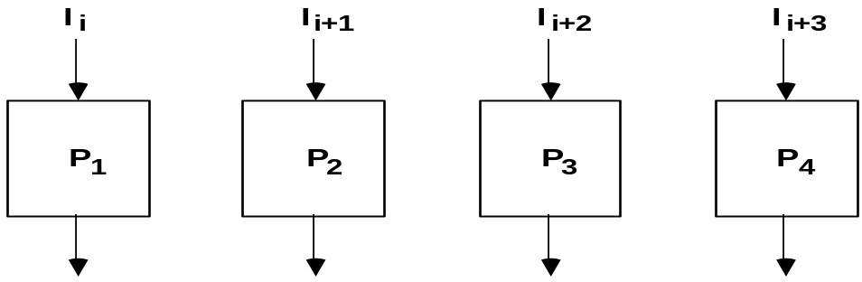
PIPELINE AND MULTIPLE FUNCTION UNITS
Pipelining
Example
- 4-stage pipeline
- subopertion in each stage; t_{p} = 20nS
- 100 tasks to be executed
- 1 task in non-pipelined system; 20*4 = 80nS
Pipelined System
(k + n - 1)*t_{p} = (4 + 99) * 20 = 2060nS
Non-Pipelined System
n*k*t_{p} = 100 * 80 = 8000nS
Speedup
S_{k} = 8000 / 2060 = 3.88
4-Stage Pipeline is basically identical to the system
with 4 identical function units
Multiple Functional Units

Slide 18
ARITHMETIC PIPELINE
Arithmetic Pipeline
Floating-point adder
Exponents
Mantissas
a
b
A
B
X = A x 2ª
Y = B x 2^{b}
R
R
[1] Compare the exponents
[2] Align the mantissa
[3] Add/sub the mantissa
[4] Normalize the result
Segment 1:
Compare
Difference
exponents
by subtraction
R
Segment 2:
Choose exponent
Align mantissa
R
Segment 3:
Add or subtract
mantissas
R
R
Segment 4:
Adjust
Normalize
exponent
result
R
R

Slide 19
4-STAGE FLOATING POINT ADDER
Arithmetic Pipeline
p
q
A = a x 2
B = b x 2
p
a
q
b
Stages:
Exponent
Other
Fraction
S1
subtractor
fraction
selector
r = max(p,q)
Fraction with min(p,q)
t = |p - q|
Right shifter
S2
Fraction
adder
r
c
Leading zero
S3
counter
c
Left shifter
r
d
Exponent
S4
adder
s
d
r
s
C = A + B = c x 2 = d x 2
(r = max (p,q), 0.5 ≤ d < 1)

Slide 20
INSTRUCTION CYCLE
Instruction Pipeline
Six Phases* in an Instruction Cycle
[1] Fetch an instruction from memory
[2] Decode the instruction
[3] Calculate the effective address of the operand
[4] Fetch the operands from memory
[5] Execute the operation
[6] Store the result in the proper place
* Some instructions skip some phases
* Effective address calculation can be done in
the part of the decoding phase
* Storage of the operation result into a register
is done automatically in the execution phase
==> 4-Stage Pipeline
[1] FI: Fetch an instruction from memory
[2] DA: Decode the instruction and calculate
the effective address of the operand
[3] FO: Fetch the operand
[4] EX: Execute the operation

Slide 21
INSTRUCTION PIPELINE
Instruction Pipeline
Execution of Three Instructions in a 4-Stage Pipeline
Conventional
i
FI
DA
FO
EX
i+1
FI
DA
FO
EX
i+2
FI
DA
FO
EX
Pipelined
i
FI
DA
FO
EX
i+1
FI
DA
FO
EX
i+2
FI
DA
FO
EX

Slide 22
INSTRUCTION EXECUTION IN A 4-STAGE PIPELINE
Instruction Pipeline
Segment1:
Fetch instruction
from memory
Decode instruction
Segment2:
and calculate
effective address
yes
Branch?
no
Segment3:
Fetch operand
from memory
Segment4:
Execute instruction
Interrupt
yes
Interrupt?
handling
no
Update PC
Empty pipe
Step:
1
2
3
4
5
6
7
8
9
10
11
12
13
Instruction
1
FI
DA
FO
EX
2
FI
DA
FO
EX
(Branch)
3
FI
DA
FO
EX
4
FI
FI
DA
FO
EX
5
FI
DA
FO
EX
6
FI
DA
FO
EX
7
FI
DA
FO
EX

Slide 23
MAJOR HAZARDS IN PIPELINED EXECUTION
Instruction Pipeline
  Structural hazards(Resource Conflicts)
  Hardware Resources required by the instructions in
  simultaneous overlapped execution cannot be met
  Data hazards (Data Dependency Conflicts)
  An instruction scheduled to be executed in the pipeline requires the
  result of a previous instruction, which is not yet available
  R1 <- B + C
  R1 <- R1 + 1
ADD
DA
B,C
+
Data dependency
INC
DA
bubble
R1
+1
  Control hazards
  Branches and other instructions that change the PC
  make the fetch of the next instruction to be delayed
JMP
ID
PC
+
PC
Branch address dependency
bubble
IF
ID
OF
OE
OS
Hazards in pipelines may make it
necessary to stall the pipeline
Pipeline Interlock:
Detect Hazards Stall until it is cleared

Slide 24
STRUCTURAL HAZARDS
Instruction Pipeline
Structural Hazards
Occur when some resource has not been
duplicated enough to allow all combinations
of instructions in the pipeline to execute
Example: With one memory-port, a data and an instruction fetch
cannot be initiated in the same clock
i
FI
DA
FO
EX
i+1
FI
DA
FO
EX
i+2
stall
stall
FI
DA
FO
EX
The Pipeline is stalled for a structural hazard
<- Two Loads with one port memory
-> Two-port memory will serve without stall

Slide 25
DATA HAZARDS
Instruction Pipeline
Data Hazards
Occurs when the execution of an instruction
depends on the results of a previous instruction
ADD R1, R2, R3
SUB R4, R1, R5
Data hazard can be dealt with either hardware
techniques or software technique
Hardware Technique
Interlock
- hardware detects the data dependencies and delays the scheduling
of the dependent instruction by stalling enough clock cycles
Forwarding (bypassing, short-circuiting)
- Accomplished by a data path that routes a value from a source
(usually an ALU) to a user, bypassing a designated register. This
allows the value to be produced to be used at an earlier stage in the
pipeline than would otherwise be possible
Software Technique
Instruction Scheduling(compiler) for delayed load

Slide 26
FORWARDING HARDWARE
Instruction Pipeline
Example:
ADD R1, R2, R3
SUB R4, R1, R5
3-stage Pipeline
I: Instruction Fetch
A: Decode, Read Registers,
ALU Operations
E: Write the result to the destination register
Register
file
MUX
MUX
Bypass
path
Result
write bus
ALU
R4
ALU result buffer
ADD
I
A
E
SUB
I
A
E
Without Bypassing
SUB
I
A
E
With Bypassing

Slide 27
INSTRUCTION SCHEDULING
Instruction Pipeline
a = b + c;
d = e - f;
Unscheduled code:
Scheduled Code:
LW Rb, b
LW Rc, c
ADD Ra, Rb, Rc
SW a, Ra
LW Re, e
LW Rf, f
SUB Rd, Re, Rf
SW d, Rd
LW Rb, b
LW Rc, c
LW Re, e
ADD Ra, Rb, Rc
LW Rf, f
SW a, Ra
SUB Rd, Re, Rf
SW d, Rd
Delayed Load
A load requiring that the following instruction not use its result

Slide 28
CONTROL HAZARDS
Instruction Pipeline
Branch Instructions
- Branch target address is not known until
the branch instruction is completed
- Stall -> waste of cycle times
Branch
Instruction
FI DA FO EX
Next
Instruction
FI DA FO EX
Target address available
Dealing with Control Hazards
* Prefetch Target Instruction
* Branch Target Buffer
* Loop Buffer
* Branch Prediction
* Delayed Branch

Slide 29
CONTROL HAZARDS
Instruction Pipeline
Prefetch Target Instruction
  Fetch instructions in both streams, branch not taken and branch taken
  Both are saved until branch branch is executed. Then, select the right
  instruction stream and discard the wrong stream
Branch Target Buffer(BTB; Associative Memory)
  Entry: Addr of previously executed branches; Target instruction
  and the next few instructions
  When fetching an instruction, search BTB.
  If found, fetch the instruction stream in BTB;
  If not, new stream is fetched and update BTB
Loop Buffer(High Speed Register file)
  Storage of entire loop that allows to execute a loop without accessing memory
Branch Prediction
  Guessing the branch condition, and fetch an instruction stream based on
  the guess. Correct guess eliminates the branch penalty
Delayed Branch
  Compiler detects the branch and rearranges the instruction sequence
  by inserting useful instructions that keep the pipeline busy
  in the presence of a branch instruction

Slide 30
RISC PIPELINE
RISC Pipeline
RISC
- Machine with a very fast clock cycle that
executes at the rate of one instruction per cycle
<- Simple Instruction Set
Fixed Length Instruction Format
Register-to-Register Operations
Instruction Cycles of Three-Stage Instruction Pipeline
Data Manipulation Instructions
I: Instruction Fetch
A: Decode, Read Registers, ALU Operations
E: Write a Register
Load and Store Instructions
I: Instruction Fetch
A: Decode, Evaluate Effective Address
E: Register-to-Memory or Memory-to-Register
Program Control Instructions
I: Instruction Fetch
A: Decode, Evaluate Branch Address
E: Write Register(PC)

Slide 31
DELAYED LOAD
RISC Pipeline
  LOAD: R1 ← M[address 1]
  LOAD: R2 ← M[address 2]
  ADD: R3 ← R1 + R2
  STORE: M[address 3] ← R3
Three-segment pipeline timing
Pipeline timing with data conflict
clock cycle 1 2 3 4 5 6
Load R1 I A E
Load R2 I A E
Add R1+R2 I A E
Store R3 I A E
Pipeline timing with delayed load
clock cycle 1 2 3 4 5 6 7
Load R1 I A E
Load R2 I A E
NOP I A E
Add R1+R2 I A E
Store R3 I A E
The data dependency is taken
care by the compiler rather
than the hardware

Slide 32
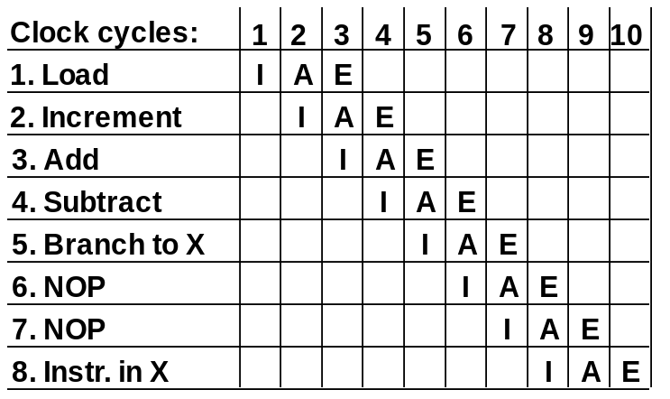
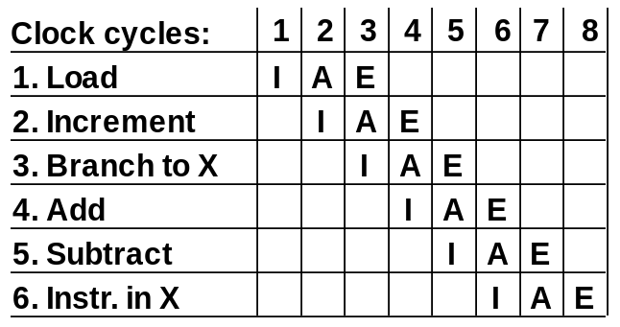
DELAYED BRANCH
RISC Pipeline
Compiler analyzes the instructions before and after
the branch and rearranges the program sequence by
inserting useful instructions in the delay steps
Using no-operation instructions
Rearranging the instructions

Slide 33
VECTOR PROCESSING
Vector Processing
Vector Processing Applications
Problems that can be efficiently formulated in terms of vectors
  Long-range weather forecasting
  Petroleum explorations
  Seismic data analysis
  Medical diagnosis
  Aerodynamics and space flight simulations
  Artificial intelligence and expert systems
  Mapping the human genome
  Image processing
Vector Processor (computer)
Ability to process vectors, and related data structures such as matrices
and multi-dimensional arrays, much faster than conventional computers
Vector Processors may also be pipelined

Slide 34
VECTOR PROGRAMMING
Vector Processing
DO 20 I = 1, 100
20 C(I) = B(I) + A(I)
Conventional computer
Initialize I = 0
20 Read A(I)
Read B(I)
Store C(I) = A(I) + B(I)
Increment I = i + 1
If I ≤ 100 goto 20
Vector computer
C(1:100) = A(1:100) + B(1:100)

Slide 35
VECTOR INSTRUCTIONS
Vector Processing
f1: V ∗ V
f2: V ∗ S
f3: V x V ∗ V
f4: V x S ∗ V
V: Vector operand
S: Scalar operand
Type Mnemonic Description (I = 1, ..., n)
  f1 VSQR Vector square root B(I) ∗ SQR(A(I))
  VSIN Vector sine B(I) ∗ sin(A(I))
  VCOM Vector complement A(I) ∗ A(I)
  f2 VSUM Vector summation S ∗ Σ A(I)
  VMAX Vector maximum S ∗ max{A(I)}
  f3 VADD Vector add C(I) ∗ A(I) + B(I)
  VMPY Vector multiply C(I) ∗ A(I) * B(I)
  VAND Vector AND C(I) ∗ A(I) . B(I)
  VLAR Vector larger C(I) ∗ max(A(I),B(I))
  VTGE Vector test > C(I) ∗ 0 if A(I) < B(I)
  C(I) ∗ 1 if A(I) > B(I)
  f4 SADD Vector-scalar add B(I) ∗ S + A(I)
  SDIV Vector-scalar divide B(I) ∗ A(I) / S

Slide 36
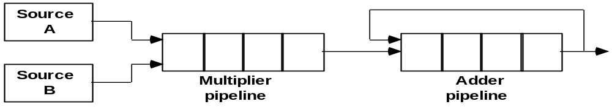
VECTOR INSTRUCTION FORMAT
Vector Processing
Vector Instruction Format
Pipeline for Inner Product

Slide 37
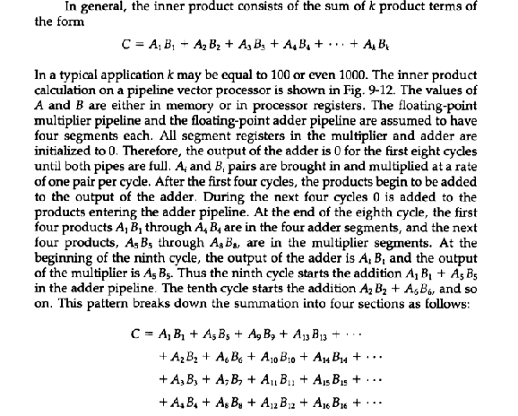
Matrix Multiplication using Vector Processor

Slide 38
MULTIPLE MEMORY MODULE AND INTERLEAVING
Vector Processing
Multiple Module Memory
Address bus
M0 M1 M2 M3
AR
AR
AR
AR
Memory
Memory
Memory
Memory
array
array
array
array
DR
DR
DR
DR
Data bus
Address Interleaving
Different sets of addresses are assigned to
different memory modules

Slide 39
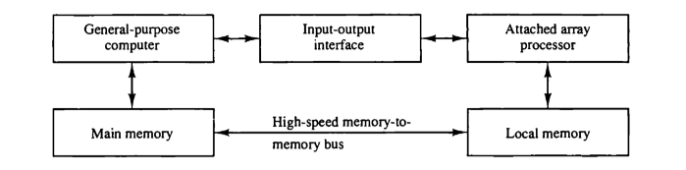
Array Processor
Attached Array Processor to Host Computer

Slide 40
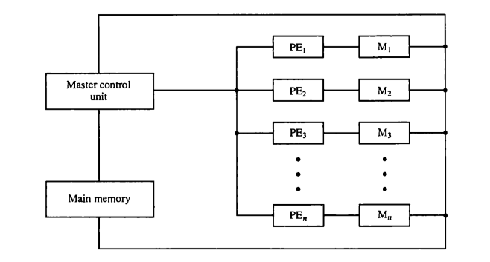
Array Processor
SIMD Array Processor Organization

